Slide 1
Analysis of Algorithms
Estimate the running time
Estimate the memory space required.
Time and space depend on the input size.
Analysis of Algorithms

Slide 2

Running Time (§3.1)
Most algorithms transform input objects into output objects.
The running time of an algorithm typically grows with the input size.
Average case time is often difficult to determine.
We focus on the worst case running time.
  Easier to analyze
  Crucial to applications such as games, finance and robotics
Analysis of Algorithms

Slide 3

Experimental Studies
Write a program implementing the algorithm
Run the program with inputs of varying size and composition
Use a method like System.currentTimeMillis() to get an accurate measure of the actual running time
Plot the results
Analysis of Algorithms

Slide 4

Limitations of Experiments
It is necessary to implement the algorithm, which may be difficult
Results may not be indicative of the running time on other inputs not included in the experiment.
In order to compare two algorithms, the same hardware and software environments must be used
Analysis of Algorithms

Slide 5

Theoretical Analysis
Uses a high-level description of the algorithm instead of an implementation
Characterizes running time as a function of the input size, n.
Takes into account all possible inputs
Allows us to evaluate the speed of an algorithm independent of the hardware/software environment
Analysis of Algorithms

Slide 6
Pseudocode (§3.2)
Example: find max element of an array
High-level description of an algorithm
More structured than English prose
Less detailed than a program
Preferred notation for describing algorithms
Hides program design issues
Algorithm arrayMax(A, n)
Input array A of n integers
Output maximum element of A
currentMax ← A[0]
for i ← 1 to n − 1 do
if A[i] > currentMax then
currentMax ← A[i]
return currentMax
Analysis of Algorithms

Slide 7
Pseudocode Details
Control flow
  if … then … [else …]
  while … do …
  repeat … until …
  for … do …
  Indentation replaces braces
Method declaration
  Algorithm method (arg [, arg…])
  Input …
  Output …
Expressions
  Assignment
  (like = in Java)
  Equality testing
  (like == in Java)
  n² Superscripts and other mathematical formatting allowed
Analysis of Algorithms

Slide 8

Primitive Operations (time unit)
Basic computations performed by an algorithm
Identifiable in pseudocode
Largely independent from the programming language
Exact definition not important (we will see why later)
Assumed to take a constant amount of time in the RAM model
Examples:
  Evaluating an expression
  Assigning a value to a variable
  Indexing into an array
  Calling a method
  Returning from a method
  Comparison x==y
  x>Y
Analysis of Algorithms

Slide 9
Counting Primitive Operations (§3.4)
By inspecting the pseudocode, we can determine the maximum number of primitive operations executed by an algorithm, as a function of the input size
Algorithm arrayMax(A, n)
# operations
currentMax ← A[0] 2
for (i =1; i<n; i++) 2n
(i=1 once, i<n n times, i++ (n-1) times)
if A[i] > currentMax then 2(n − 1)
currentMax ← A[i] 2(n − 1)
return currentMax 1
Total 6n −1
Analysis of Algorithms

Slide 10

Estimating Running Time
Algorithm arrayMax executes 6n − 1 primitive operations in the worst case.
Define:
  a = Time taken by the fastest primitive operation
  b = Time taken by the slowest primitive operation
Let T(n) be worst-case time of arrayMax. Then
a (6n − 1) ≤ T(n) ≤ b(6n − 1)
Hence, the running time T(n) is bounded by two linear functions
Analysis of Algorithms

Slide 11

Growth Rate of Running Time
Changing the hardware/ software environment
  Affects T(n) by a constant factor, but
  Does not alter the growth rate of T(n)
The linear growth rate of the running time T(n) is an intrinsic property of algorithm arrayMax
Analysis of Algorithms

Slide 12
n | logn | n | nlogn | n² | n³ | 2^{n}
4 | 2 | 4 | 8 | 16 | 64 | 16
8 | 3 | 8 | 24 | 64 | 512 | 256
16 | 4 | 16 | 64 | 256 | 4,096 | 65,536
32 | 5 | 32 | 160 | 1,024 | 32,768 | 4,294,967,296
64 | 6 | 64 | 384 | 4,094 | 262,144 | 1.84 * 10¹⁹
128 | 7 | 128 | 896 | 16,384 | 2,097,152 | 3.40 * 10³⁸
256 | 8 | 256 | 2,048 | 65,536 | 16,777,216 | 1.15 * 10⁷⁷
512 | 9 | 512 | 4,608 | 262,144 | 134,217,728 | 1.34 * 10¹⁵⁴
1024 | 10 | 1,024 | 10,240 | 1,048,576 | 1,073,741,824 | 1.79 * 10³⁰⁸
The Growth Rate of the Six Popular functions
Analysis of Algorithms

Slide 13
Big-Oh Notation
To simplify the running time estimation,
for a function f(n), we ignore the constants and lower order terms.
Example: 10n³+4n²-4n+5 is O(n³).
Analysis of Algorithms

Slide 14
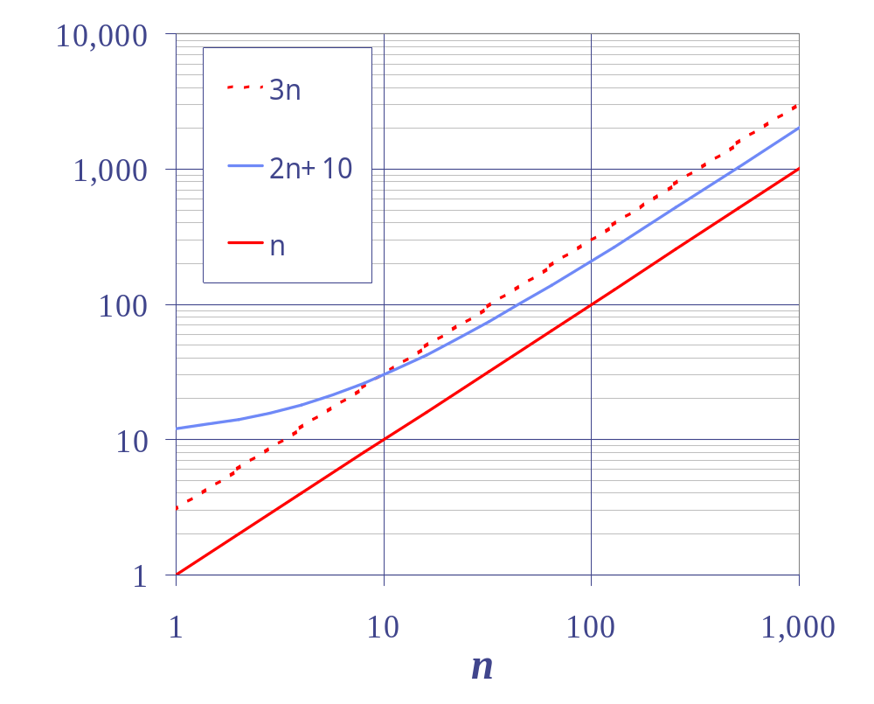
Big-Oh Notation (Formal Definition)
Given functions f(n) and g(n), we say that f(n) is O(g(n)) if there are positive constants
c and n₀ such that
f(n) ≤ cg(n) for n ≥ n₀
Example: 2n + 10 is O(n)
  2n + 10 ≤ cn
  (c − 2) n ≥ 10
  n ≥ 10/(c − 2)
  Pick c = 3 and n₀ = 10
Analysis of Algorithms

Slide 15
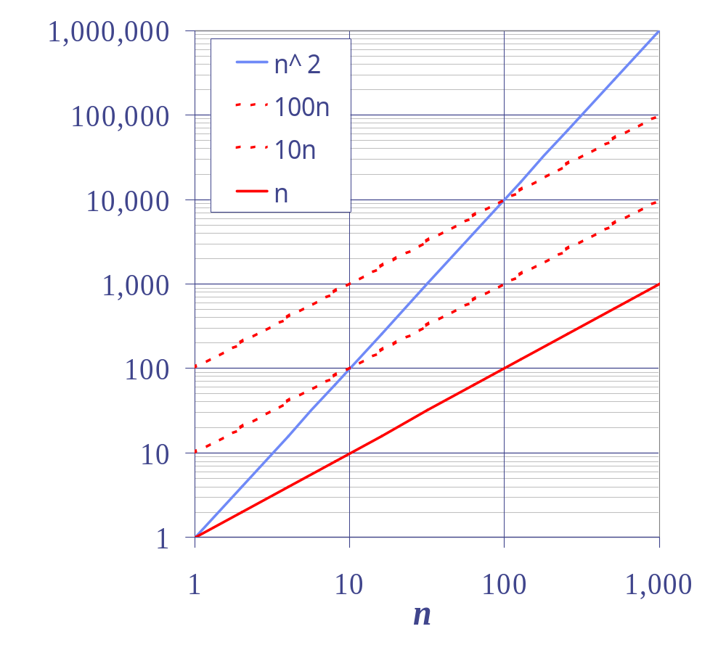
Big-Oh Example
Example: the function n² is not O(n)
  n² ≤ cn
  n ≤ c
  The above inequality cannot be satisfied since c must be a constant
  n² is O(n²).
Analysis of Algorithms

Slide 16


More Big-Oh Examples
7n-2
  7n-2 is O(n)
  need c > 0 and n₀ ≥ 1 such that 7n-2 ≤ c•n for n ≥ n₀
  this is true for c = 7 and n₀ = 1
3n³ + 20n² + 5
  3n³ + 20n² + 5 is O(n³)
  need c > 0 and n₀ ≥ 1 such that 3n³ + 20n² + 5 ≤ c•n³ for n ≥ n₀
  this is true for c = 4 and n₀ = 21
3 log n + 5
  3 log n + 5 is O(log n)
  need c > 0 and n₀ ≥ 1 such that 3 log n + 5 ≤ c•log n for n ≥ n₀
  this is true for c = 8 and n₀ = 2
Analysis of Algorithms

Slide 17
Big-Oh and Growth Rate
The big-Oh notation gives an upper bound on the growth rate of a function
The statement “f(n) is O(g(n))” means that the growth rate of f(n) is no more than the growth rate of g(n)
We can use the big-Oh notation to rank functions according to their growth rate
Analysis of Algorithms

Slide 18

Big-Oh Rules
If f(n) is a polynomial of degree d, then f(n) is O(n^{d}), i.e.,
  Drop lower-order terms
  Drop constant factors
Use the smallest possible class of functions
  Say “2n is O(n)” instead of “2n is O(n²)”
Use the simplest expression of the class
  Say “3n + 5 is O(n)” instead of “3n + 5 is O(3n)”
Analysis of Algorithms

Slide 19
Growth Rate of Running Time
Consider a program with time complexity O(n²).
For the input of size n, it takes 5 seconds.
If the input size is doubled (2n), then it takes 20 seconds.
Consider a program with time complexity O(n).
For the input of size n, it takes 5 seconds.
If the input size is doubled (2n), then it takes 10 seconds.
Consider a program with time complexity O(n³).
For the input of size n, it takes 5 seconds.
If the input size is doubled (2n), then it takes 40 seconds.
Analysis of Algorithms

Slide 20
Asymptotic Algorithm Analysis
The asymptotic analysis of an algorithm determines the running time in big-Oh notation
To perform the asymptotic analysis
  We find the worst-case number of primitive operations executed as a function of the input size
  We express this function with big-Oh notation
Example:
  We determine that algorithm arrayMax executes at most 6n − 1 primitive operations
  We say that algorithm arrayMax “runs in O(n) time”
Since constant factors and lower-order terms are eventually dropped anyhow, we can disregard them when counting primitive operations
Analysis of Algorithms

Slide 21

Computing Prefix Averages
We further illustrate asymptotic analysis with two algorithms for prefix averages
The i-th prefix average of an array X is average of the first (i + 1) elements of X:
A[i] = (X[0] + X[1] + … + X[i])/(i+1)
Computing the array A of prefix averages of another array X has applications to financial analysis
Analysis of Algorithms

Slide 22
Prefix Averages (Quadratic)
The following algorithm computes prefix averages in quadratic time by applying the definition
Algorithm prefixAverages1(X, n)
Input array X of n integers
Output array A of prefix averages of X #operations
A ← new array of n integers n
for i ← 0 to n − 1 do n
{ s ← X[0] n
for j ← 1 to i do 1 + 2 + …+ (n − 1)
s ← s + X[j] 1 + 2 + …+ (n − 1)
A[i] ← s / (i + 1) } n
return A 1
Analysis of Algorithms

Slide 23
Arithmetic Progression
The running time of prefixAverages1 is
O(1 + 2 + …+ n)
The sum of the first n integers is n(n + 1) / 2
  There is a simple visual proof of this fact
Thus, algorithm prefixAverages1 runs in O(n²) time
Analysis of Algorithms

Slide 24
Prefix Averages (Linear)
The following algorithm computes prefix averages in linear time by keeping a running sum
Algorithm prefixAverages2(X, n)
Input array X of n integers
Output array A of prefix averages of X #operations
A ← new array of n integers n
s ← 0 1
for i ← 0 to n − 1 do n
{s ← s + X[i] n
A[i] ← s / (i + 1) } n
return A 1
Algorithm prefixAverages2 runs in O(n) time
Analysis of Algorithms

Slide 25

Exercise: Give a big-Oh characterization
Algorithm Ex1(A, n)
Input an array X of n integers
Output the sum of the elements in A
s ← A[0]
for i ← 0 to n − 1 do
s ← s + A[i]
return s
Analysis of Algorithms

Slide 26
Exercise: Give a big-Oh characterization
Algorithm Ex2(A, n)
Input an array X of n integers
Output the sum of the elements at even cells in A
s ← A[0]
for i ← 2 to n − 1 by increments of 2 do
s ← s + A[i]
return s
Analysis of Algorithms

Slide 27
Exercise: Give a big-Oh characterization
Algorithm Ex1(A, n)
Input an array X of n integers
Output the sum of the prefix sums A
s ← 0
for i ← 0 to n − 1 do
{ s ← s + A[0]
for j← 1 to i do
s ← s + A[j]
}
return s
Analysis of Algorithms

Slide 28
Remarks:
In the first tutorial, ask the students to try programs with running time O(n), O(n log n), O(n²), O(n²log n), O(2^{n}) with various inputs.
They will get intuitive ideas about those functions.
for (i=1; i<=n; i++)
for (j=1; j<=n; j++)
{ x=x+1; delay(1 second);
}
Analysis of Algorithms

